Slide 1
2B Tutorial 3 – Semester 2 2019
16 September 2019

Slide 2
Agenda – Tutorial 3
Appraisal Value – Common Sense Explanation
Definition
Simple Example
Market Consistent Embedded Value
Embedded Value in Action - AMP’s Investor Report
Assignment Question
Looking ahead to the exam

Slide 3
Appraisal Value – Common Sense Explanation
How much is the company worth?

Slide 4
Appraisal Value – Definition
1. Net Assets (Free Surplus in excess of Capital Requirements)
+
2. Value of Inforce Business (Discounted Future Distributable Profits and release of Capital from Existing Business) due to:
a) Insurance Cover
Future premiums exceed claims and expenses
b) Investment / Savings
Future policy charges exceed expenses
+
3. Value of Future New Business
        The discount rate may be higher to allow for the risk of future savings not being achieved
        May just calculate the value of one year’s new business and multiply by an annuity factor
Embedded Value

Slide 5
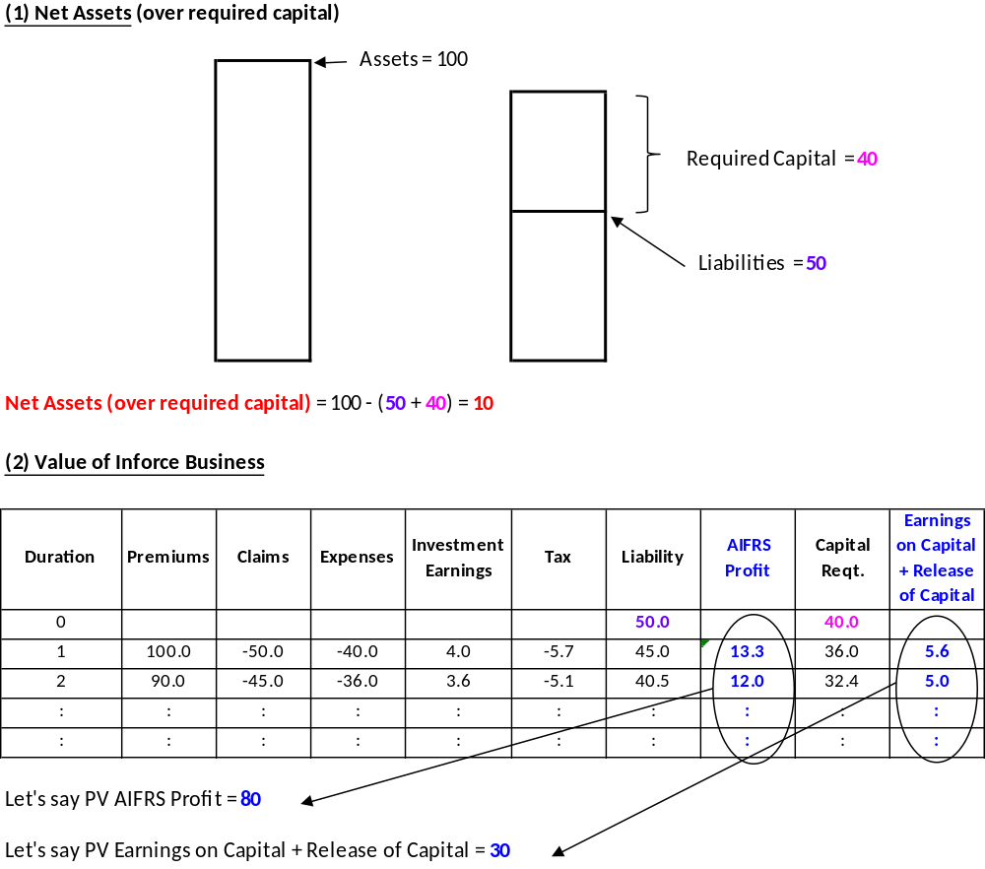
Diagrammatically

Slide 6
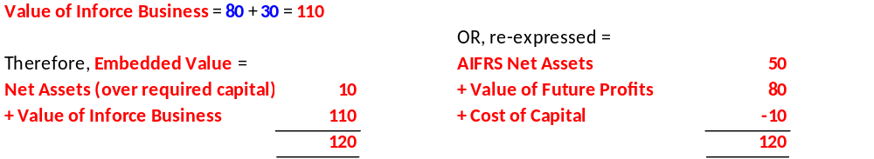
Diagrammatically (cont.)

Slide 7
Consistency
The liabilities and capital requirements must be consistent between Net Assets and Value of Inforce Business

Slide 8
Assumptions
Economic
  Discount rate
  Asset earnings rates
  Inflation (expenses and products)
  Ensure internally consistent
Other
  Mortality (improvements projected?)
  Morbidity
  Persistency
  Term
  Expenses (improvements projected?)
Sensitive
  Especially gaps between various economic assumptions
  Expense levels, especially renewal
  Bases differ from pricing and statutory valuation

Slide 9
Assumptions
Conceptually should be best estimate so starting point for demographic assumptions is MoS
Investment assumptions likely to differ

Slide 10
Simple Example
Policy for 2 years, as follows:-
  $100 invested by policyholder
  $120 Capital reserve set up
  $100 x (1.05)² - $4 = 106.25
  Discount Rate = 10%
  Earning rate = 5%
Cap Ad reserve at any time t
= 120 x (1.05)^{t}
Fee deducted at end year
= $4
120 x (1.05)²
= 132.3 Cap Ad
released
$100 invested
t = 1
$120 Cap Ad
106.25 paid
to investor
t = 0
t = 2

Slide 11
Simple Example (cont.)
  2 policies are inforce at valuation date. 1 will mature in one year (1st policy); the other will mature in 2 years (2nd policy)
  1 additional policy is written at the end of the 1st year following the valuation date (3rd policy)
  Closed to new business thereafter
  Assets = $300
1st policy matures
132.3 Capital reserve released
106.25 paid to investor
2nd policy matures
3rd policy matures
Val^{n} Date
n = 0
n = 1
n = 2
n = 3
New policy written
$100 invested
$120 Capital reserve set up

Slide 12
Simple example - at t = 0
Capital reserve for 2nd policy
Capital reserve for 1st policy
        1. Net Assets = 300 – 120 – 126
        = 54
        2. VIF = (132.3 – 106.25) x (1.1) ⁻¹ + (132.3 – 106.25) x (1.1) ^{– 2}
        = 45.21
3. VFNB = (100 -120) x (1.1) ⁻¹ + (132.3 – 106.25) x (1.1) ⁻³
= 1.39
⇒ AV (0) = 100.60
Release from
1st policy
Release from
2nd policy
Strain from
3rd policy
Release from
3rd policy

Slide 13
Simple example - at t = 1
Paid to 1st investor
Received from 3rd investor
1. Net Worth = 300 x (1.05) - 106.25 + 100 – 120 - 126
        = 62.75
2. VIF = (132.3 – 106.25) x (1.1) ⁻¹ + (132.3 – 106.25) x (1-1) ⁻²
= 45.21
3. VFNB = 0
AV (1) = 107.96
AV Profit = AV (1) – AV (0)
= 7.36
Assets at
n = 0
Inv earnings
Capital reserve for 2nd policy
Capital reserve for 3rd policy
Release from
2nd policy
Release from
3rd policy

Slide 14
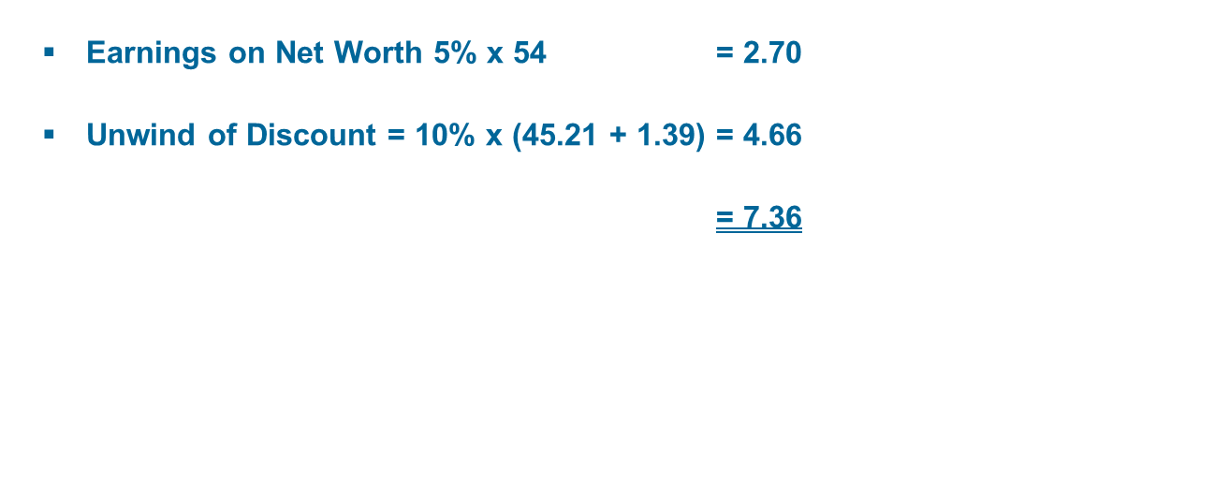
Simple example - Analysis of Profit

Slide 15
Market Consistent Embedded Value - Rationale
  To avoid asset arbitrage (sell a bond and purchase shares increases Traditional EV). EV goes up as you assume a much higher earning rate.
  To assist comparatives between companies (under Traditional EV, companies use different risk margins for investment assumptions)
  Counter argument: These can be allowed for under Traditional EV via a change in the Risk Discount Rate.

Slide 16
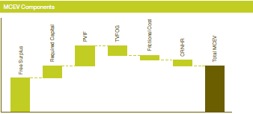
Market Consistent Embedded Value - Components
Free Surplus = Assets – Cap Ad liabilities
Required Capital = Cap Ad Liabilities less AIFRS Liabilities
PVIF = Present Value of Inforce AIFRS profits, at risk free discount rate
TVOG = Time Value of Options and Guarantees
  Typically costs of Asymmetric Risks; eg Capital Guaranteed, Capital Protected Options, Whole of Life
  (But these can also be allowed for under Traditional EV).

Slide 17
Market Consistent Embedded Value - Components
Frictional Cost
These can be:
Tax and investment costs. (Allowed for by: RDR is gross risk free rate; investment earning assumption is gross risk free earning rate less investment costs less tax)
Agency Costs (Employees self interest may not be in Company best interest)
Cost of Financial Distress
Cost of Non-hedgeable Risk (CNHR); eg
Operational Risk
Credit Risk
Persistency Risk
Pandemic
Allowed for at a high level as:
Addition to RDR
% of Capital Requirement
Page <number> |

Slide 18
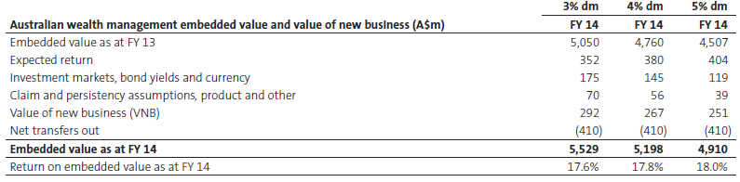
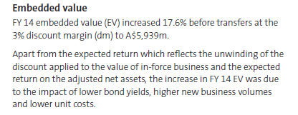

EV in action – AMP Investor Report

Slide 19
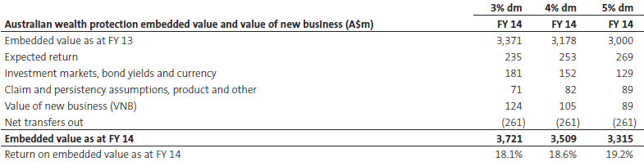
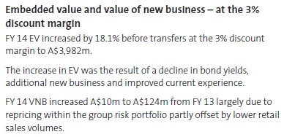
EV in action – AMP Investor Report

Slide 20
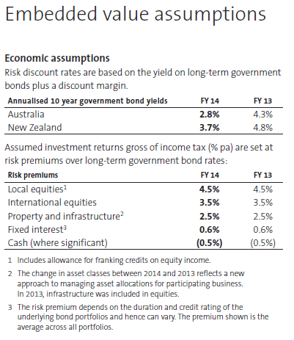
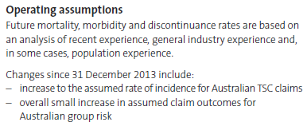
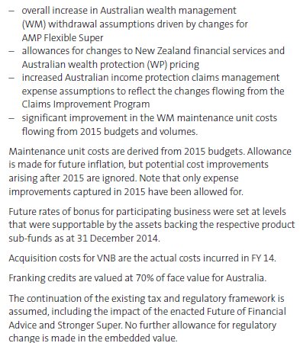
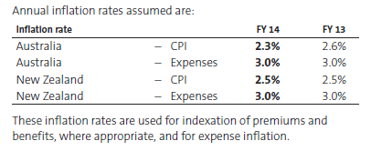
EV in Action – AMP Investor Report

Slide 21
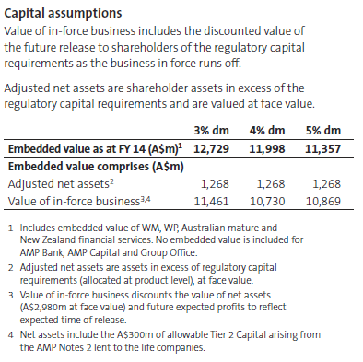
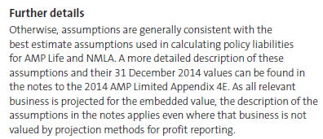
EV in Action – AMP Investor Report

Slide 22
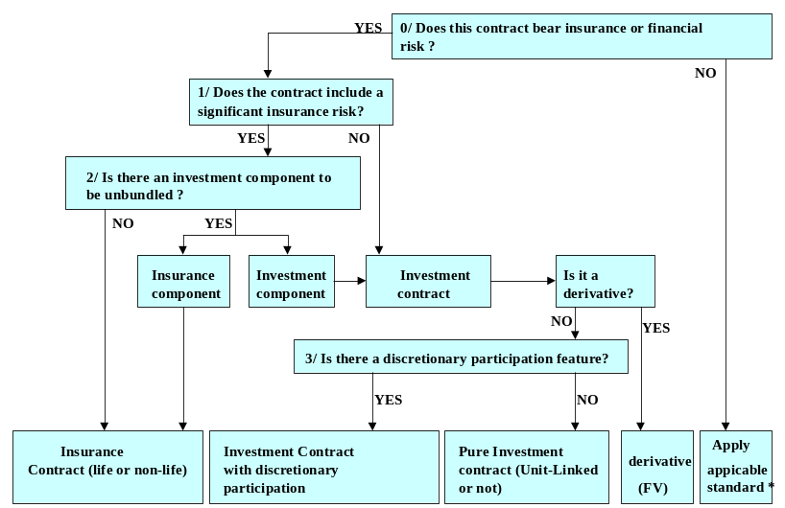
Assignment Question – let’s recap from Tutorial 1:
IFRS 4 IFRS 4 IAS39
AASB1038 AASB1038 AASB139
LPS340 LPS340

Slide 23

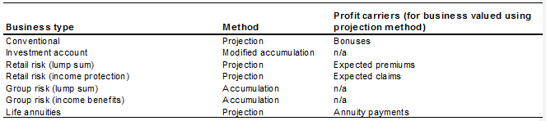
Assignment Question – let’s recap from Tutorial 1:

Slide 24
Assignment Question – let’s recap from Tutorial 1 – Asymmetric Risk Reserve
What?
  A reserve to reflect the value of any options or guarantees offered as part of a product.
  The options and guarantees are usually related to investment returns but can also be related to continuation options of insurance policies.
  Forms part of the BEL.
Why?
  Introduced as part of IFRS changes to make the BEL more fair value based.
  A recognition of the short-comings of traditional deterministic projections.
How?
  Usually based on stochastic modelling taking into account guarantees offered in the policy, current investment market levels and volatility.
  Needs to consider the current level of PFSHPM, PVPHPM, PRPs, product manager discretion and local regulations on setting future bonus and crediting rates.

Slide 25
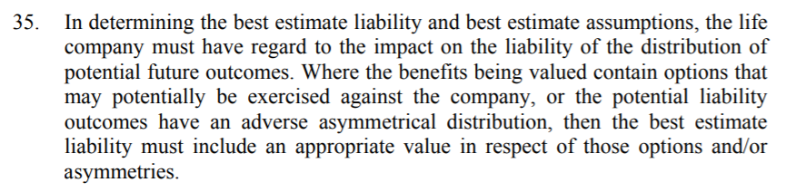
Assignment Question – let’s recap from Tutorial 1 – Asymmetric Risk Reserve

Slide 26
Assignment Question
Investment Account with Investment Fluctuation Reserve
It is CAPITAL GUARANTEED. CREDITING RATE CAN’T BE NEGATIVE.
Annual Premiums

Slide 27
Assignment Question
and (c) – see my spreadsheet. Let’s go through it.
In the solution to I’m surprised there is no mention of asymmetric risk reserve. I would certainly mention that as a bullet point. Would
In (b) other important points are in relation to maintaining the IFR to protect the capital guarantee; e.g.
Declared crediting rates should not ‘give away’ (i.e. declare) the capital gains on fixed interest assets from falling interest rates. Otherwise you won’t have any IFR to provide protection when interest rates rise.
Likewise careful of giving away reductions in crediting spreads.
Need to ensure IFR is sufficient to avoid an unfunded asymmetric risk charge for liabilities or capital.

Slide 28
Assignment Question
(d) IFS is important to support the capital guarantee without the shareholder putting in a lot of capital.
For (i) although not explicitly asked in the question, it is important to consider past policy disclosure and marketing material to consider policyholder reasonable expectations.

Slide 29
Looking ahead to the exam
  Disclaimer
  You should prepare well for your exam and be able to answer questions about all topics on the course.
  The following is a personal “guess” for discussion purposes and is not “actuarial advice” on which to base study decisions!!
  I have no knowledge whatsoever about what is on the exam and have not discussed it with the Chief Examiner

Slide 30
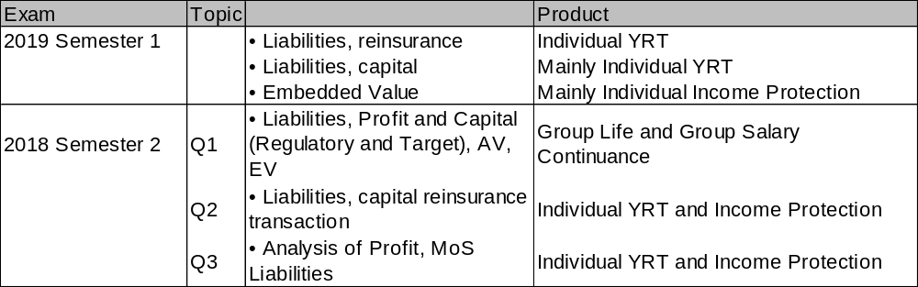
Recent Exam Questions

Slide 31
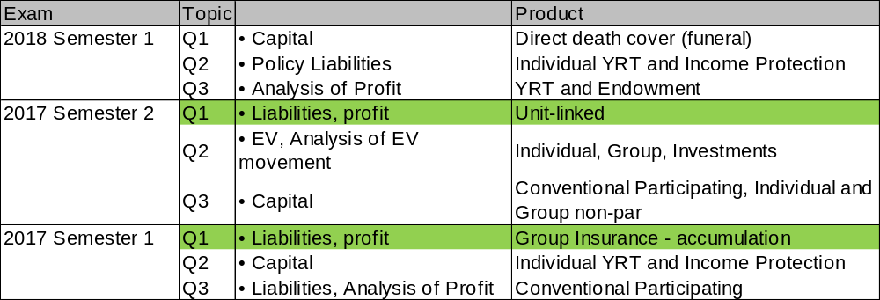
Recent Exam Questions

Slide 32
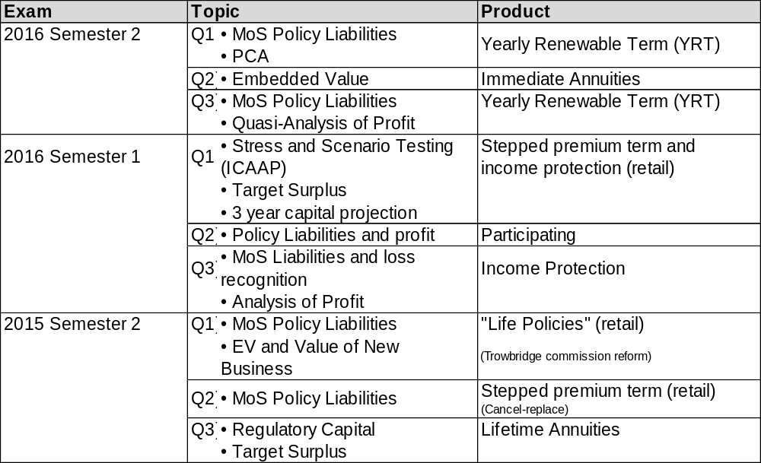
Recent Exam Questions

Slide 33
Topical Life Insurance Issues
  (As measured by papers presented at Actuaries Summit, Actuaries Institute Insights session, LIWMPC newsletter topics, APRA Insights publication)
  New LPS320 – Role of the Appointed Actuary. Valuation Report, Analysis of Movement of Capital
  Industry fragmentation – AMP sale
  Royal Commission
  Productivity Commission
  APRA – challenges for individual income protection
  New IFRS 17 for Insurance Contracts

Slide 34
Looking ahead to the exam
  And I’ve always thought it would be great to have a question of analysis of movement in capital position but it’s never got on. I previously prepared an example question, but nothing similar has ever got on.
  I’ve added this question at the end but we won’t go through it.

Slide 35
2019???

Slide 36
Possible ICAAP Exam Question
  ABC Life is a medium-sized Australian life company which is the local subsidiary of a large overseas parent life company. It has one statutory fund. It has a significant portfolio of lifetime annuities and also is the life insurer to two large industry funds (with one of these being won at competitive tender during the past year).
  ABC Life has implemented its ICAAP but an internal report has identified “room for improvement” in its ICAAP.
  You are the Capital Management Actuary at ABC Life. The Appointed Actuary has requested that you assist her in improving the ICAAP, with the key requirements of the request being:
  Provide a pro-forma ICAAP Summary Statement for ABC life (include headings only and bullet points of what should be included under each section to meet “best practice”). 10 marks
  The ABC Board is concerned that management does not understand its capital requirements well. In its draft ICAAP Report, the actual capital requirements were much higher than expected (and it needed to seek capital from its parent company to support the industry fund insurance tender win); however there was little analysis as to why capital requirements increased. The spreadsheet attached shows ABC Life’s profit results for the year, and components of capital at start and end. The Appointed Actuary has asked you to provide an analysis of its actual capital position relative to regulatory capital and capital targets and actual-versus-planned capital management actions for its ICAAP Report. 10 marks

Slide 37
Possible Exam Question 1 (cont.)
  ABC Life’s Board feels it has a good understanding of its risk appetite but is not clear how this relates to the Target Capital it holds. Its risk appetite is:
“We have a low appetite for risk except where directly related to our core skills of providing insurance cover for customers and protecting their longevity risks
“We expect to seek capital support from our parent company no more frequently than once in every forty years (as a guide) in the normal course of business.
(The normal course of business excludes acquisitions or planned one-off business expansion. Capital support from the parent company is triggered when the excess capital over PCR exceeds 15% of the PCR).
  You have been asked to present at a Board workshop to assist them. Prepare slides for the risk management workshop, which include the stress and scenario analysis you performed for the ICAAP report and how this links to Target Capital. 10 marks

Slide 38
Broad solution
  ICAAP summary statement must cover paragraphs 13 and 14 of LPS 110; eg
  Introduction
  Objectives of ICAAP – 14(a)
  Risk Management and Capital Framework
  Brief overview of risk management and capital management frameworks – major risks and mitigation frameworks. Reference policies and documents (do not repeat the detail) – 13(a), 13(f)
  Risk appetite and tolerances including expected level of financial soundness associated with capital targets – 13(b), 14(a)
  Stress and Scenario Analysis (13(d), 14(b))
  Describe key stresses to be tested and what level; eg
  Key insurance, asset risks etc identified in APRA capital standards – but test sensitivity of capital position
  Company-specific risks not covered by APRA capital standards
  Set sensitivities at levels that may reflect risk appetite of breaching capital – may be less than the actual capital shock
  Should be a requirement for a qualitative scenario for consideration
  Assumptions and methodologies

Slide 39
Broad solution (cont)
  Target Capital (13(b), 13(e))
  Assumptions and methodologies; any differences in basis from regulatory capital measures; link to risk appetite and tolerances; consideration of management actions
  At granular level (at least by statutory fund)
  Impact on dividend policy
  Capital Management – Monitoring, Actions and Triggers (13(b), 13(c), 14(c))
  Both high level and granular
  Graduated triggers (red / amber / green)
  May be many, including de-risking assets, adjusting bonus and crediting rates, increasing liquidity, repricing, raising capital, notifying internal stakeholders, notifying APRA, increasing monitoring
  Who is responsible
  Governance (13(a), 13(b), 13(e))
  Basic requirements – eg ICAAP summary statement, ICAAP report and responsibilities
  Processes for reporting on the ICAAP and ensuring it is taken into account for business decisions
  Policy for ICAAP review
  References to external documents

Slide 40
Broad solution
  b) The requirement for actual-vs-expected capital is in 17(b) of LPS 110, so make sure you cover all of this.
  Generally the analysis of the movement in the capital position is like AMP discloses in their investor report (see tutorial 2); ie
  Starts with an analysis of profit (profit margins released, experience variances etc. This may be just shown as a single item in a capital analysis but you may have bullet point “key items”
  Then look at the movement in all items of capital margins with brief commentary for why each one moved; ie
  Regulatory adjustments (most notably for “Adjusted policy liabilities – often driven by new business strain or inforce business runoff)
  Insurance Risk
  Asset Risk
  Asset Concentration Risk
  Operational Risk
  Capital injections or dividends also impact the position
  This gives you the analysis of the actual movement. You then need to present it against the equivalent components of your expected movement.

Slide 41
Broad solution
  b) Things you would want to comment on for ABC Life are:
  The new industry fund will cause a capital strain. Operational risk capital charge will kick up because it will go over the 20% growth trigger in the LPS 118 formula
  The capital injection from the parent company
  You would need to comment on the actual vs expected management actions in raising the capital from the parent company. Was the ICAAP and Capital management considered in full when bidding for the industry fund’s insurance, or were there surprises.
  Actual target capital may have changed due to the risk profile of the new industry fund’s insurance
  May be some natural hedging from the mortality and longevity risks in the group life and annuity portfolios (but significant industry fund risk comes from disability)

Slide 42
Broad solution
  The basics of the slides should include:
  Start with risk appetite and tolerance.
  For ABC Life, the main reference point is seeking capital support from its parent, which is totally dependent regulatory capital.
  Therefore target capital is set with reference to regulatory capital (not ratings agency or economic capital)
  Broad methodology for target capital
  Show table of impacts of capital position (vs Regulatory Capital and any revised target capital¹) from sensitivities to key insurance and asset risks. Line these up against target capital – this helps the Board translate its risk appetite to capital under various scenarios
  ¹ Target capital can be pro-cyclical and the Board should be aware
  Include scenarios for company-specific risks not explicitly covered by APRA capital standards. This may include known operational risks.

